Slide 1
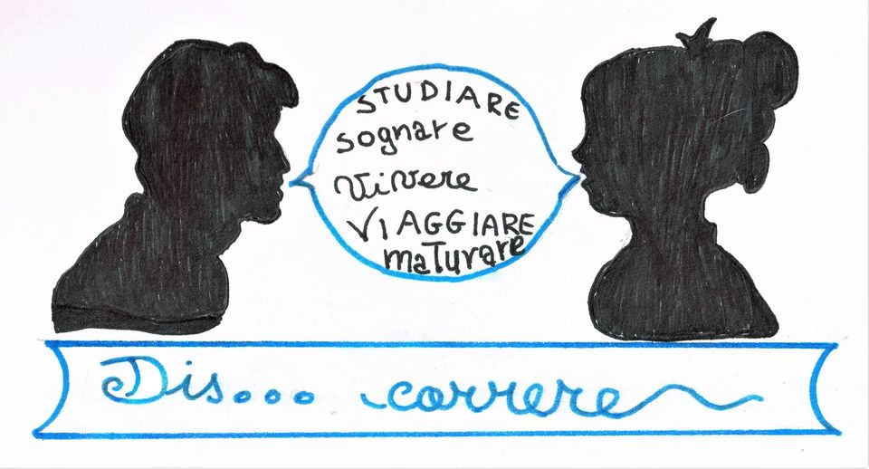

Slide 2
Benvenuti!
Merħba!

Slide 3
On the Way There…
9 meetings for project design and advice on application
July 2019 – September 2019 – Writing of project application
29th September 2019 – Submission of application
17th December 2019 – project funded !!! ☺

Slide 4
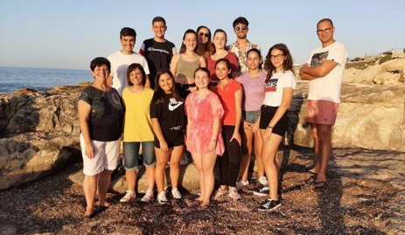
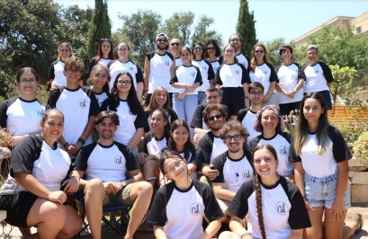
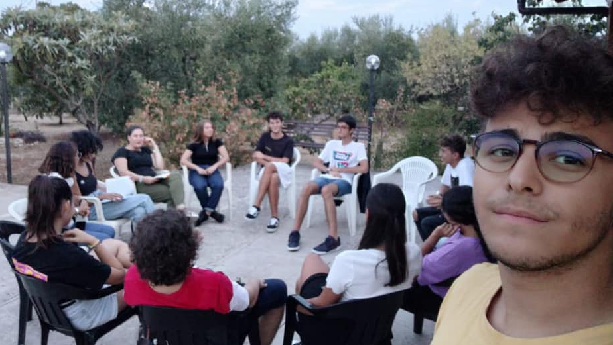
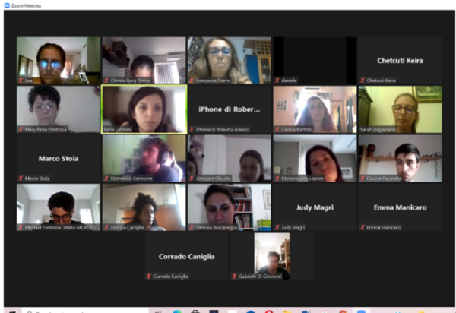
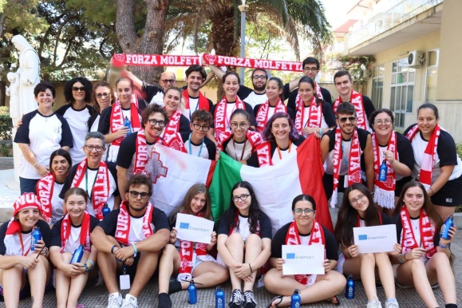
→
2020 2023
2020
2022
2023
Dyslexic Teens Dialogue - Malta
Malta Week
LOADING…
2020
2021
2022
Dis…Correre – Molfetta (Italy)
Online youth meetings
Italy Week

Slide 5
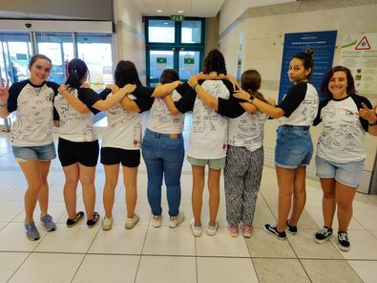
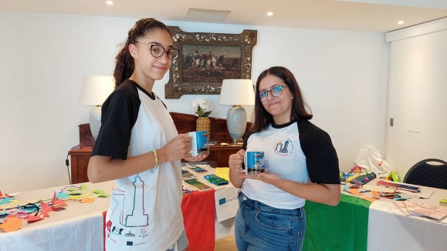
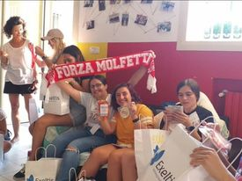
La Nostra Identità
T-Shirt
La Nostra Tazza
Goodie Bag

Slide 6
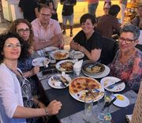
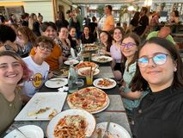
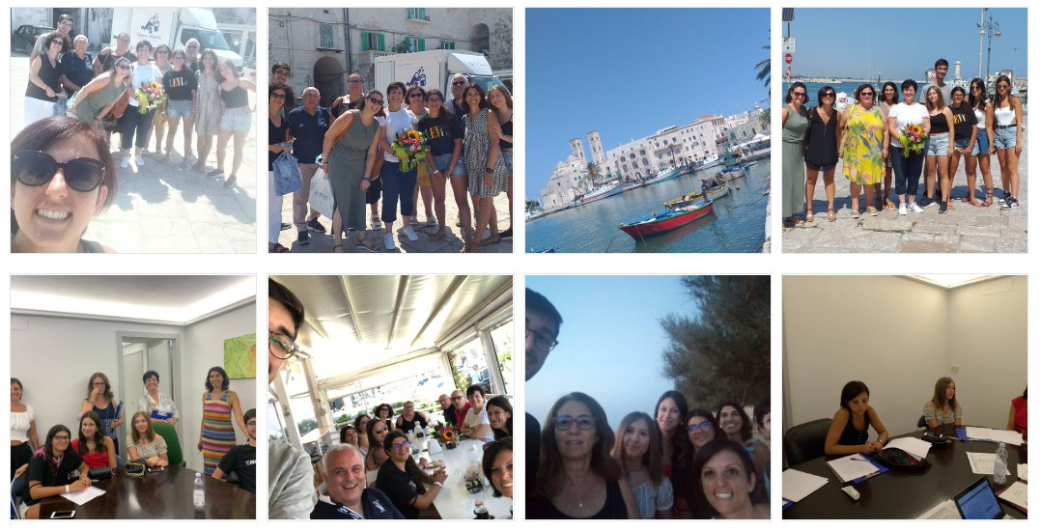
Transnational Meetings
Giugno 2022
3
Aprile 2022
2
Luglio 2021
1

Slide 7
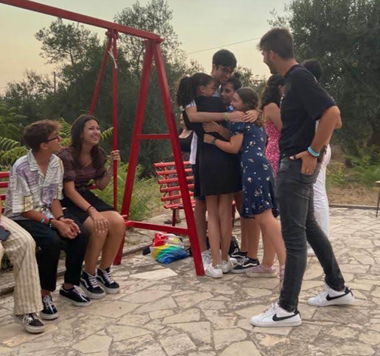
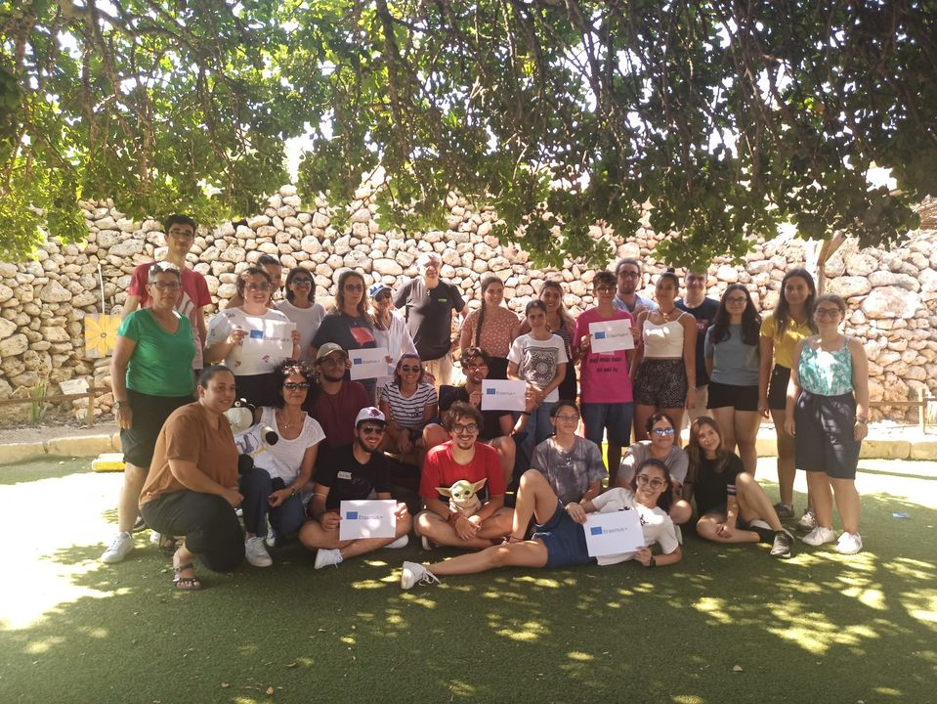
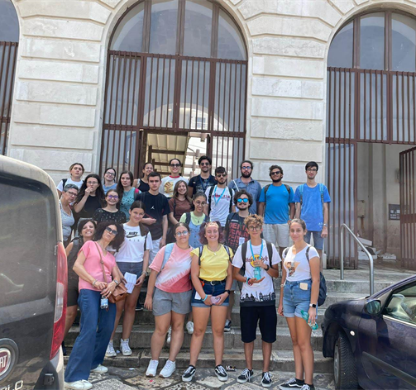
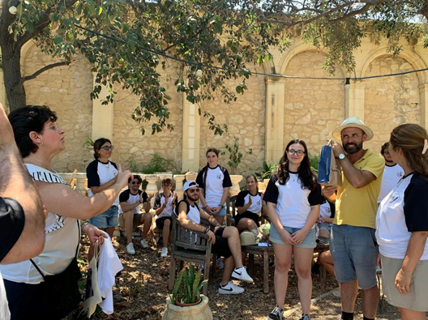
Learning, Teaching & Training
Luglio 2022, Malta
Agosto 2022, Molfetta, Italy

Slide 8
Lezioni d’Inglese:
THE ENGLISH CORNER
Sig. Mary Ann

Slide 9
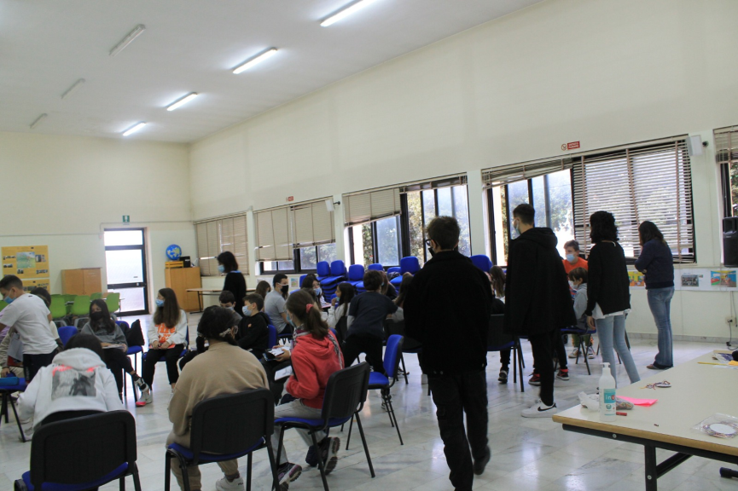
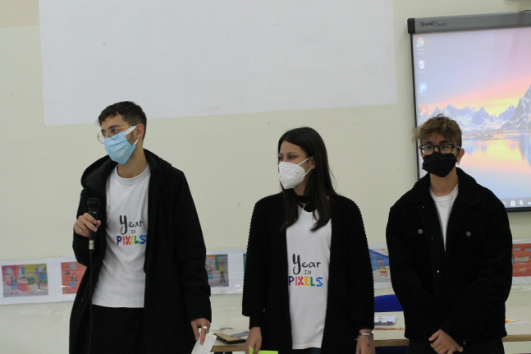
YEAR IN PIXELS

Slide 10
Learning Patterns

Slide 11
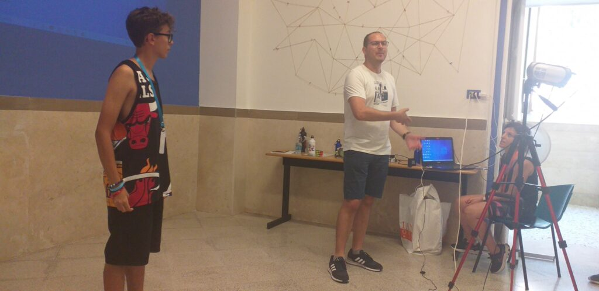
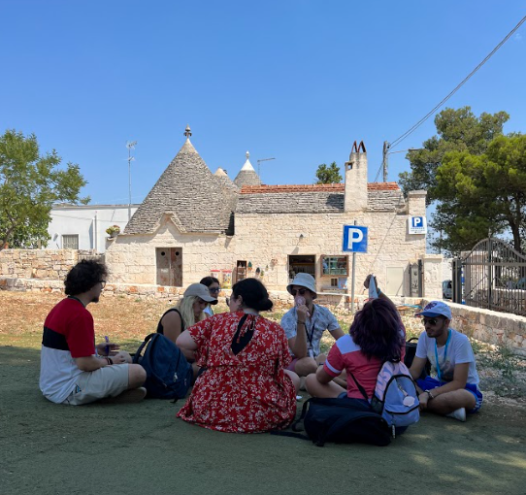
Public Speaking Skills
Con Sig. Kenny Muscat

Slide 12
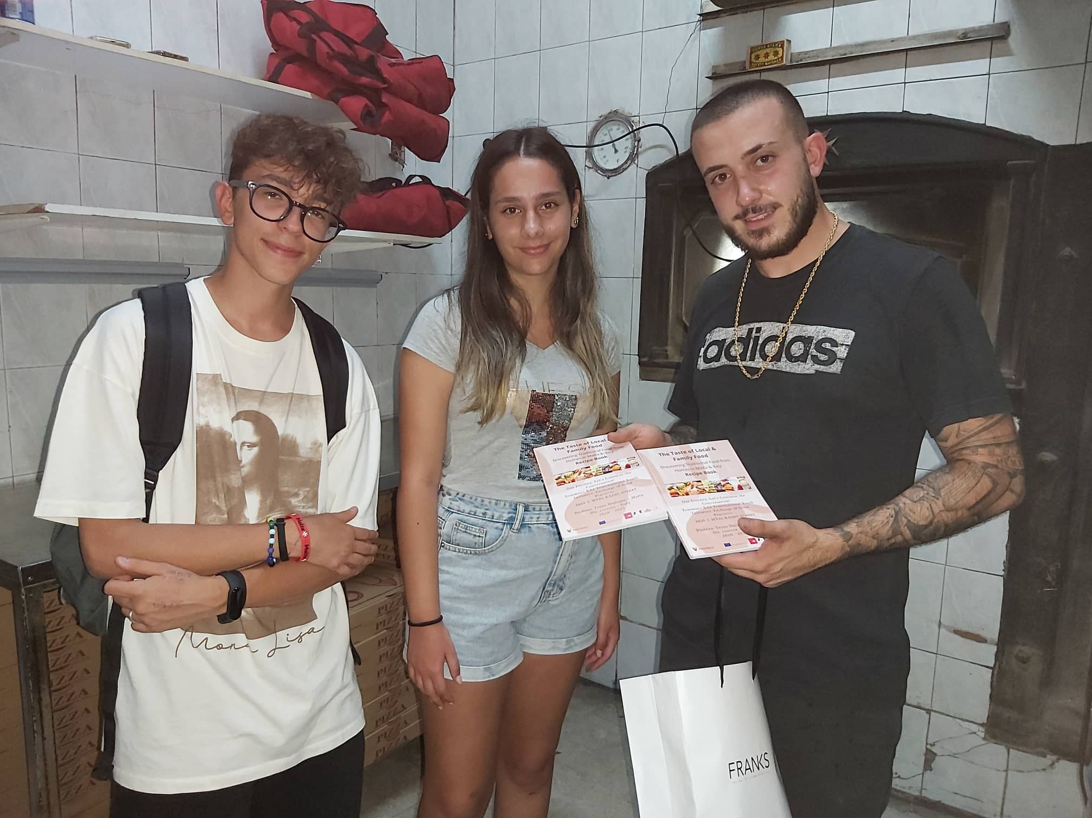
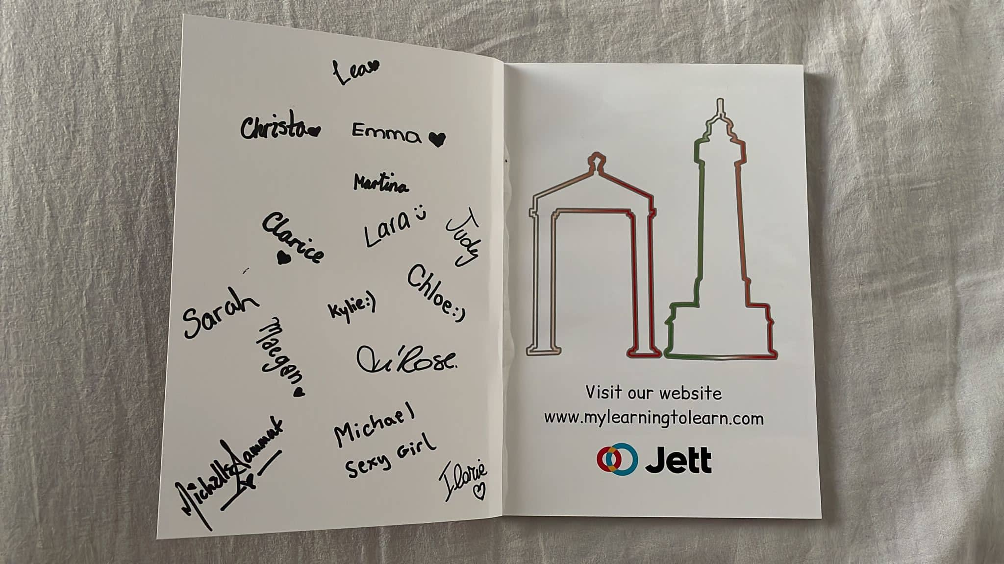
Recipe Book

Slide 13
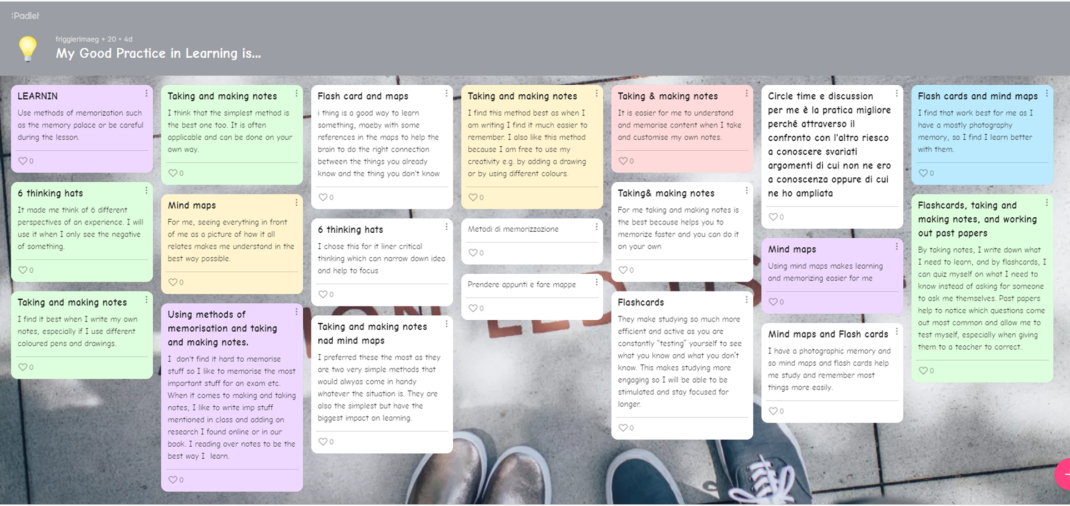
Feedback time!

Slide 14
Our Website:

Slide 16
Visit us!
www.mylearningtolearn.com

Slide 17
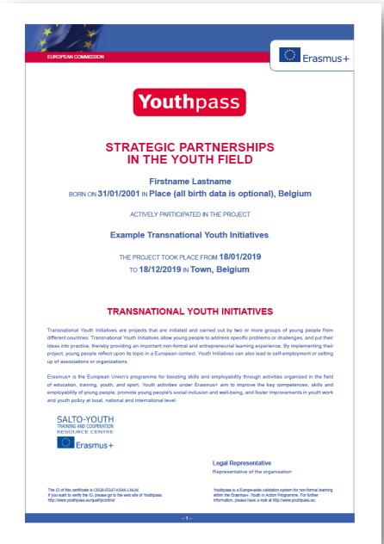
KNOWLEDGE, SKILLS & ATTITUDES … YOUTHPASS !!!

Slide 18
Teams
Chloe Muscat
Christa Borg Parnis
Clarice Bartolo
Emma Manicaro
Ilaria Labbate
Judy Magri
Katrina Bugagiar
Kenny Muscat
Kylie Sultana
Lara Sultana
Lea Sammut
Maegan Friggieri
Martina Micallef
Mary Rose Formosa
Michael Formosa
Michelle Sammut
Sarah Cassar Dymond
Shirley Scalpello
Trudie Buhagiar Argento
Alessia di Terlizzi
Beatrice de Candia
Claudia di Terlizzi
Daniele Binetti
Daniele Ragno
Davide Paparella
Domenico Centrone
Domenico Modugno
Francesca Pierro
Gabriele di Giovanni
Lidia Bufi
Marco Stoia
Maria Rosaria Lepore
Michele Modugno
Roberta Adesso
Simona Boccanegra
Dyslexic Teens Dialogue , Malta
Dis…Correre, Italy

Slide 19
Our video with
samples of good practices will
follow….

Slide 20
Grazie! Grazzi

