Slide 1
Guess the meaning of these words or phrases! By Emma Manicaro

Slide 2
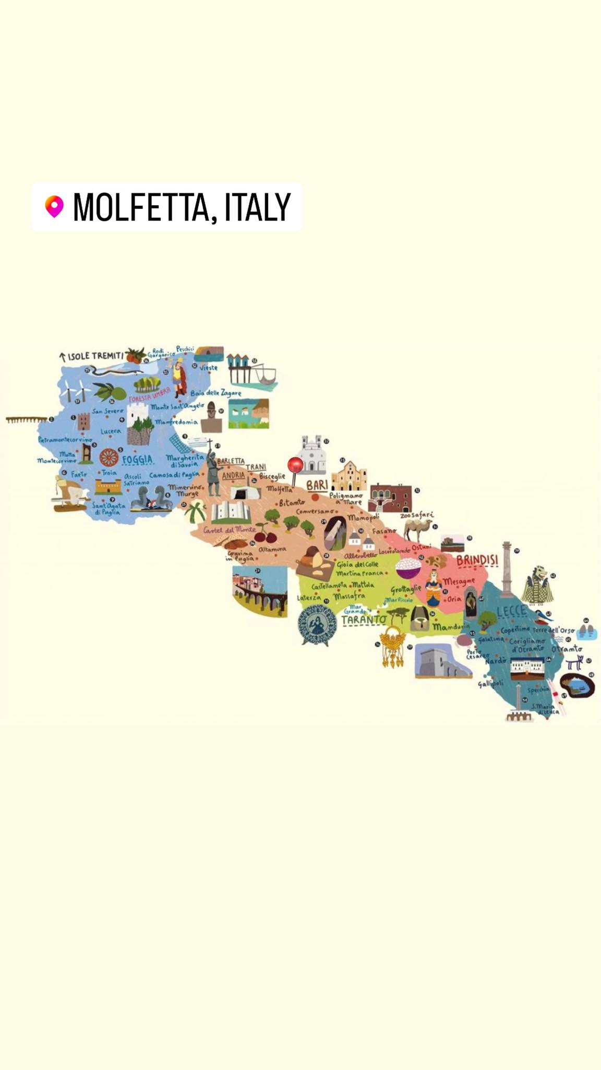
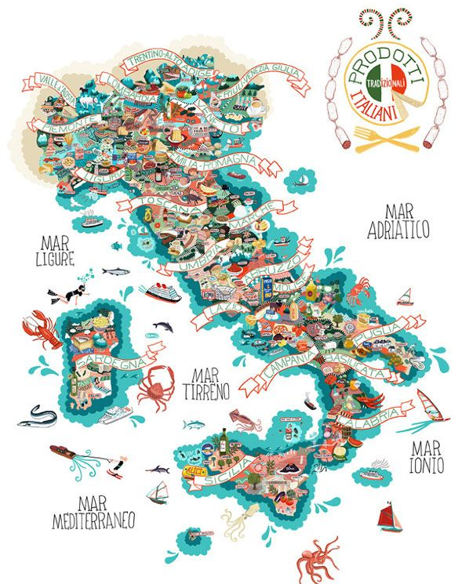

Slide 3
QUARANDENOV

Slide 4
Forty-nine

Slide 5
SCIMANINN

Slide 6
Let’s go away

Slide 7
RBUSCIAT

Slide 8
Rude

Slide 9
UGUALIO

Slide 10
You (referring to a young person)

Slide 11
Mezzadai

Slide 12
Mid-day

Slide 13
VIN ARREIT

Slide 14
Visit again

Slide 15
C NA ME SCAI SCMENIN C NA NA ME SCAI NEN SIM SCEN

Slide 16
Se dobbiamo andare via, andiamo ma se non dobbiamo andare via, non andiamo

Slide 17
If we have to go away let’s go, but if we don’t have to go away, let’s not go

Slide 18
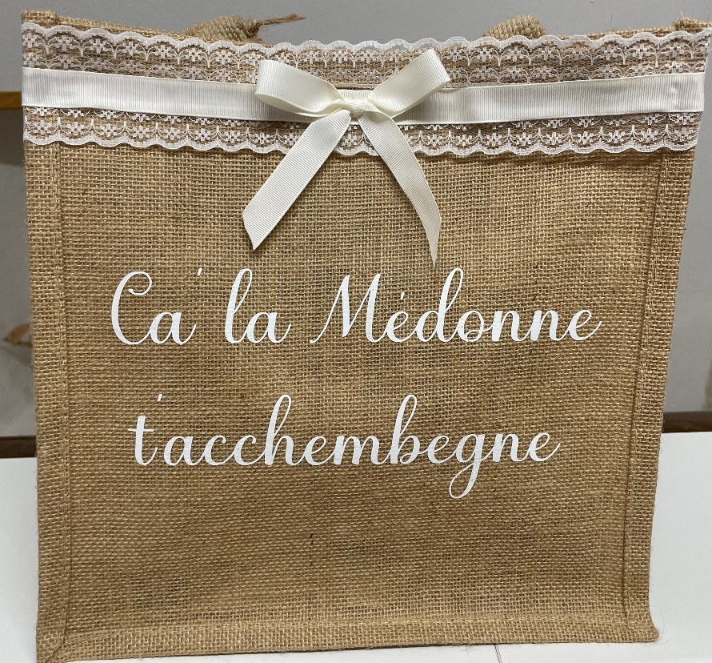
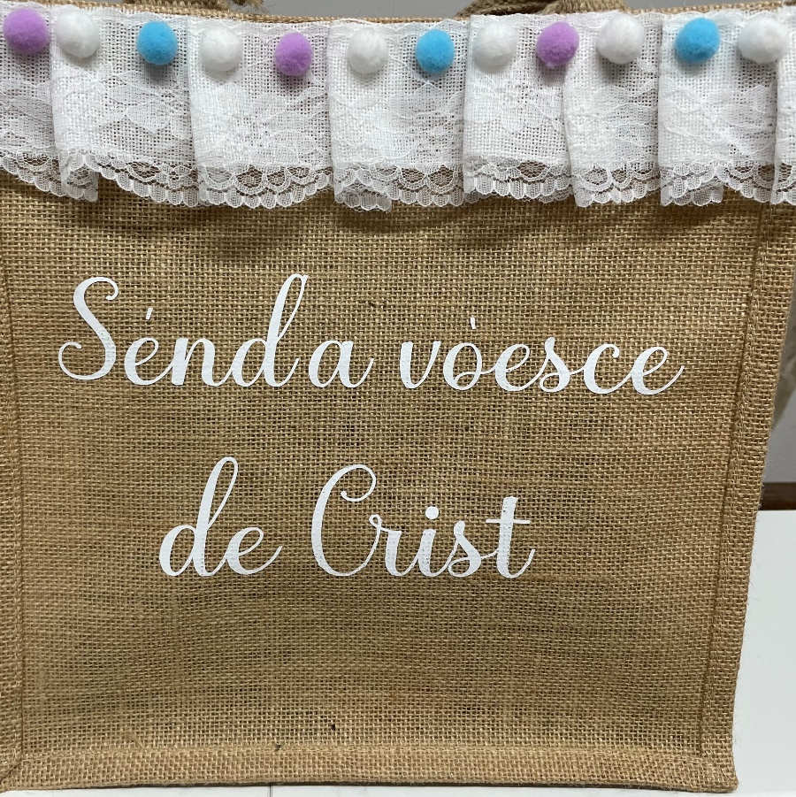
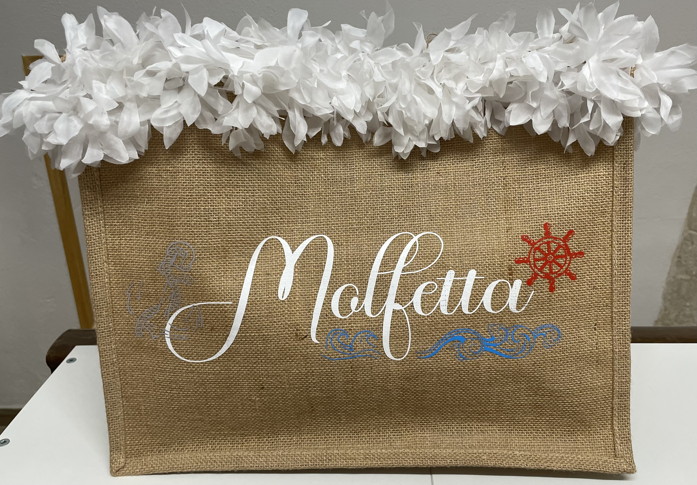
On every death of a pope (to refer to a rare event)
May Our Lady accompany you
Sacred Voice of Christ (to affirm what one has said)

Slide 19
Grazzi! Thank you!
With the participation of:
Beatrice de Candia
Daniele Giovanni Binetti
Davide Paparella
Francesca Pierro
Maria Rosaria Lepore

